Slide 1


Information Security
Chapter 01
BS-CS-VI
VVEEK-01 & 02 Lectures

Slide 2
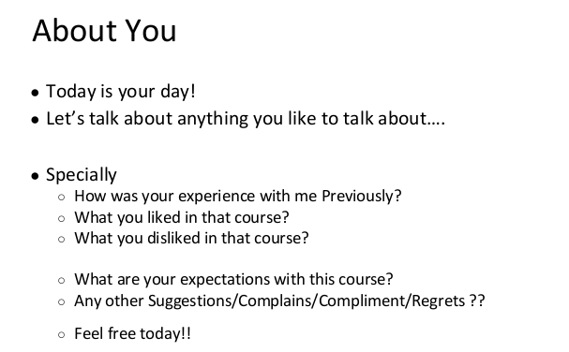
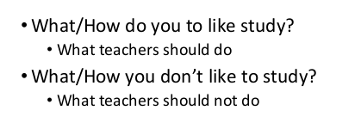

Slide 3
Outline
Introduction
Class rules
Marks distribution
Grading policy
Course portal
Course learning outcomes
Basics of IS

Slide 4
Class Rules [1/2]
Be punctual
  Late comers are not allowed
  85% attendance
Be attentive
  You pay to listen
  I get paid to speak
Be prompt
  Be always ready to learn
  Class participation is important
  Surprised quizzes

Slide 5
Class Rules [2/2]
Be polite
  Be a soft-spoken person
  Do not laugh on fellow’s questions
Be honest
  Do your work by yourself
  Do properly credit other’s work
  Cheating is an academic offense (zero marks)
  Do not waste others’ time
Be responsible
  Switch off your cell phone
  Penalty: treat for the whole class

Slide 6
Grading Distribution
Midterm 30%
Sessionals 20%
  Quiz 5%
  Assignment 5%
  Case Study 5%
  Project/Presentation 5%
Final 50%

Slide 7
Grading Policy
No best quiz/assignment
No make up (even for sessional exams)
Regular assignments
Strict submission deadlines
Zero marks for the copied quizzes/assignments

Slide 8

What Is Security?
“A state of being secure and free from danger or harm; the actions taken to make someone or something secure.”
Security is not a ‘thing’ – rather, it is a ‘process.’
Information security means keeping information safe—just like locking your house to protect your valuables.
8

Slide 9
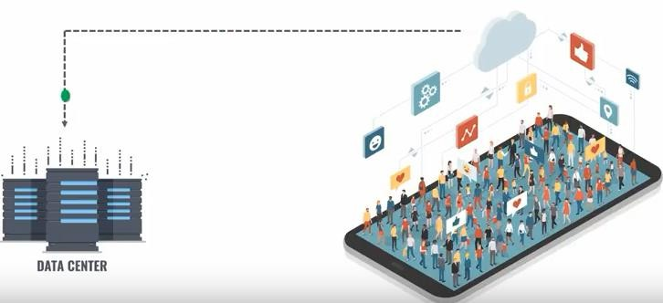
A Digital Era.
Computer systems and networks are all around us.
  Online banking
  Automated supermarket checkouts
  Online classes
  Online shopping
  Online travel resources
9

Slide 10
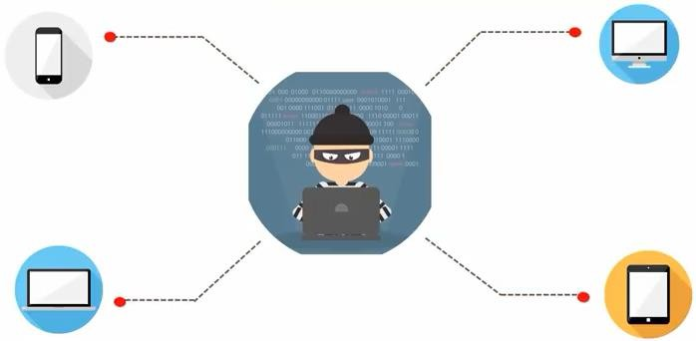
Golden Age for Data Exploits(increased opportunities for cybercriminals to exploit information)
10

Slide 11
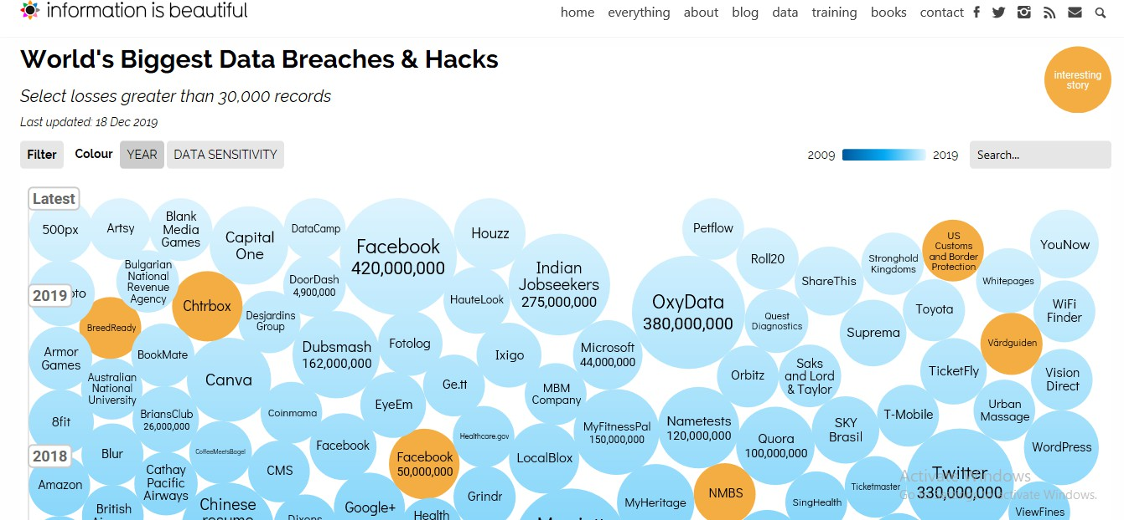
History of Cyber Attacks
11

Slide 12

Top 10 Reasons to Learn IS & Cyber security
1
1

Slide 13
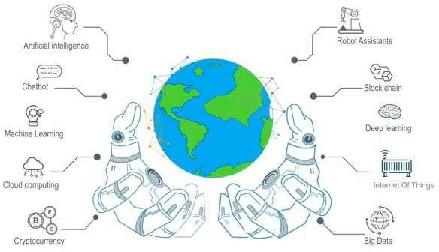
10. Evergreen Industry
1
2

Slide 14

1
3

Slide 15
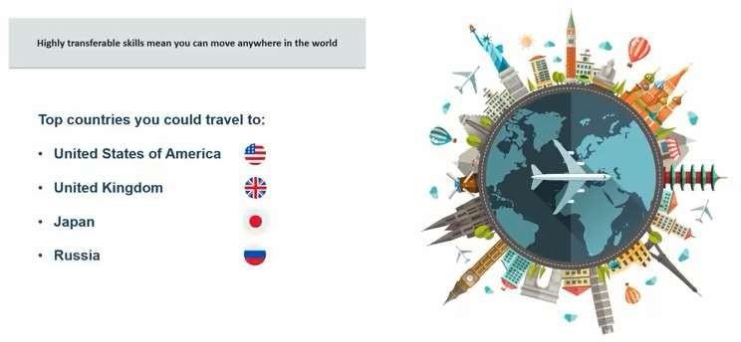
9. The World is Your Oyster (Means You have many thing to achieve)
1
4

Slide 16

1
5

Slide 17
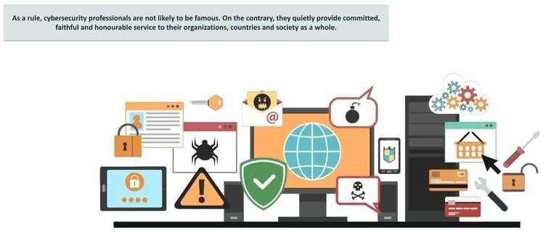
8. Working for the Greater Good
1
6

Slide 18

1
7

Slide 19
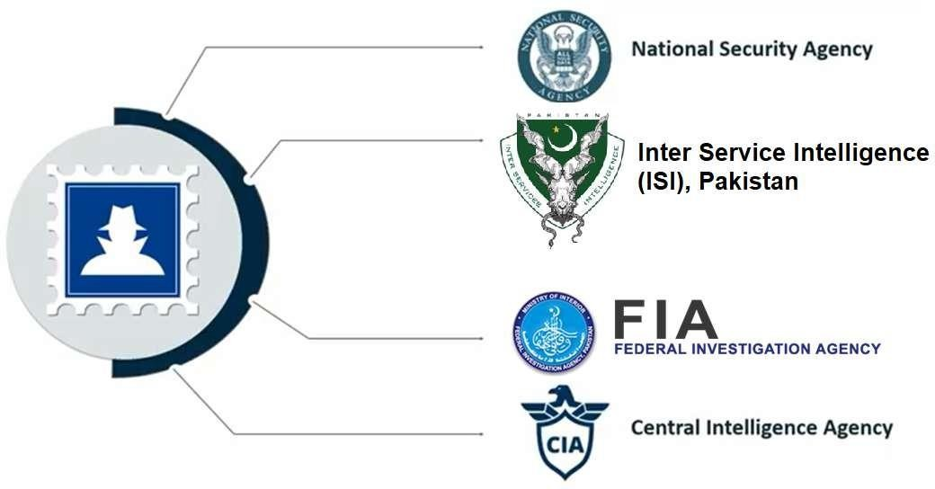
7. Work with Top Secret Agencies
10

Slide 20


Slide 21
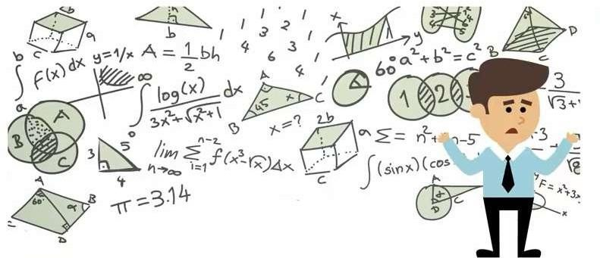
6. No Concern for Math

Slide 22

6. No Concern for Math

Slide 23


Slide 24
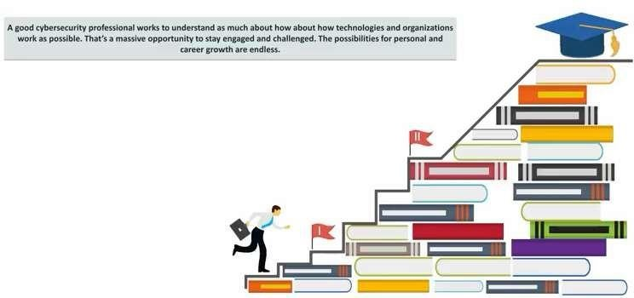
5. Unlimited Growth Potential

Slide 25


Slide 26
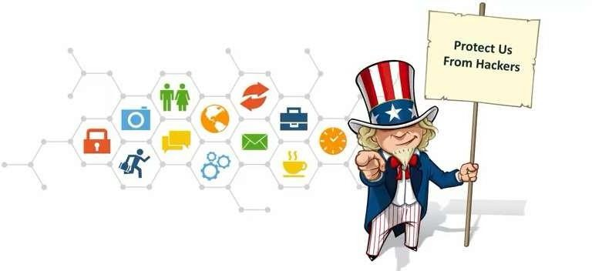
4. Everyone Wants You!

Slide 27


Slide 28
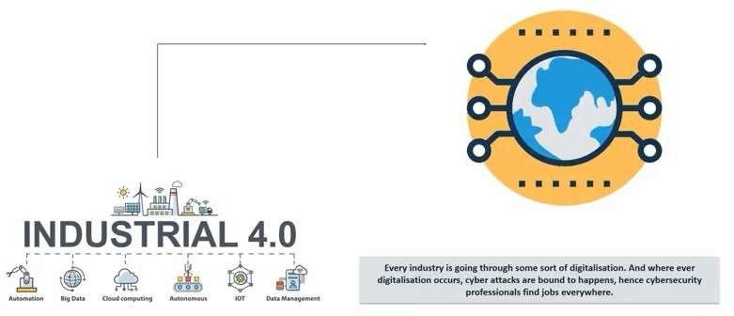
3. Variety of Industries

Slide 29

20

Slide 30
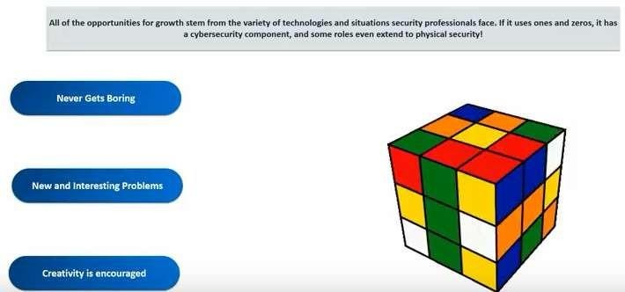
2. Dynamic and Challenging Jobs

Slide 31


Slide 32
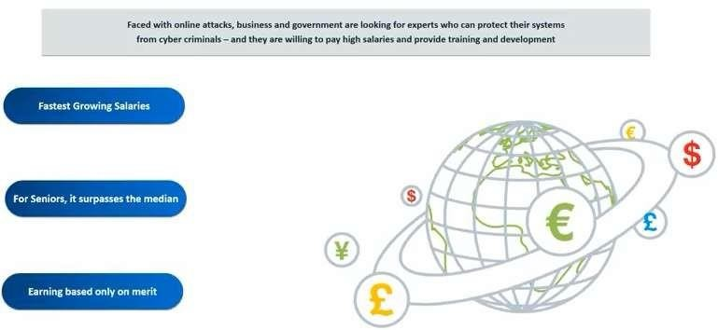
1. Money Makes the World Go Round

Slide 33
What is Information Security ?
The Committee on National Security Systems (CNSS) defines information security as the protection of information and its critical elements, including the systems and hardware that use, store, and transmit that information.
Protecting information and information systems from unauthorized access, use, disclosure, disruption, modification, or destruction.

Slide 34
What is Information Security ?
IT Security is information security applied to technology
Information security also covers physical security, human resource security, legal & compliance, organizational, and process related aspects
information systems can be a hardware like server, router, computer and process of sharing information over the internet.

Slide 35
What is Information Security ?
IT Security functions:
  Network security
  Systems security
  Application & database security
  Mobile security
InfoSec functions:
  Governance
  Policies & procedures
  Risk management
  Performance reviews

Slide 36
What is Information Security ?
What is Cyber Security ?
  Precautions taken to guard against unauthorized access to data (in electronic form) or information systems connected to the internet.
  Prevention of crime related to the internet

Slide 37
The CNSS Security Model.
Three Pillars of Information Security (CIA):
  Confidentiality: keeping information secret
  Integrity: keeping information in its original form
  Availability: keeping information and information systems available for use

Slide 38
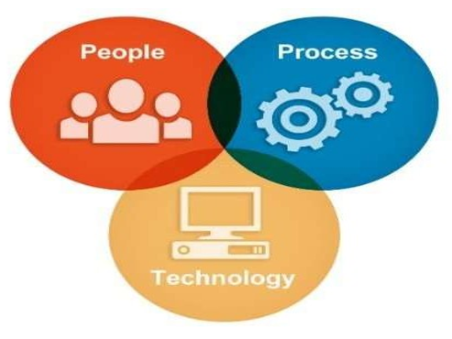
How Is Information Security Implemented ?
Three pillars of information security:
  People
  Process
  Technology

Slide 39
Why Information Security Needed ?
Information security is essential for protecting sensitive and valuable data from unauthorized access, use, disclosure, disruption, modification
The goal is to ensure the safety and privacy of critical data such as customer account details, financial data or intellectual property and critical ttechnology.

Slide 40
Why Information Security Needed ?
Information security is essential for protecting sensitive and valuable data from unauthorized access, use, disclosure, disruption, modification
The goal is to ensure the safety and privacy of critical data such as customer account details, financial data or intellectual property and critical ttechnology.
1
0

Slide 41
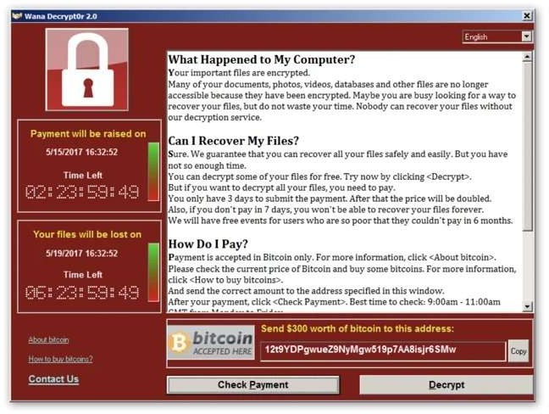
Why Information Security Needed ?
WannaCry ransomware attack
The WannaCry ransomware attack was a major security incident that impacted organizations all over the world. On May 12, 2017, the WannaCry ransomware worm spread to more than 200,000
computers in over 150 countries.
11

Slide 42
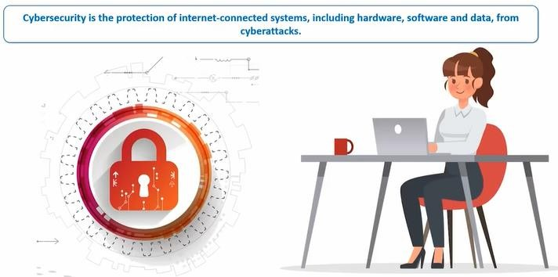
Cyber Security?
42

Slide 43
Cyber Security?
Cyber security?
  Cyber security is the protection of Internet connected system, including hardware, software, and program or data from cyber attacks.
  Precautions taken to guard against unauthorized access to data (in electronic form) or information systems connected with internet
  Prevent crime related to Internet
43

Slide 44
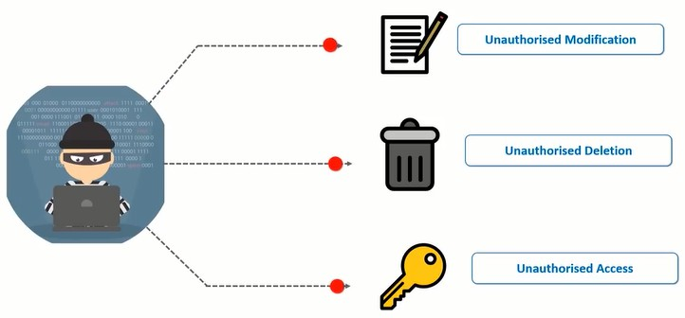
Protect Against What?
44

Slide 45
Information Security is for ?
Information security is essential for
Personal
Social media security
Online bank accounts and password
E-mail accounts
Mobile security
Smart home / smart Tv/ CCTV camera

Slide 46
Information Security is for ?
Information security is essential for
Organisation
Corporate and sensitive information
Web and database servers
Customer information
Medical records
•

Slide 47
Information Security is for ?
Information security is essential for
Govt and National
Law enforcement
Legal and Police
National Database
Critical Infrastructure

Slide 48
How Is Information Security Implemented ?
Leadership commitment:
  “Tone at the top”
  Information security policy and objectives
  Assigning responsibility and authority
  Resource allocation
  Performance reviews
  Ensuring accountability
1
6

Slide 49
How Is Information Security Implemented ?
Information Security Manager or CISO:
  Heads department responsible for implementing information security program
  Directs planning, implementation, measurement, review, and continual improvement of program
4

Slide 50
How Is Information Security Implemented ?
IT user:
  Understand policies
  Conduct security/risk assessment
  Design effective security architecture
  Develop SOPs and checklists
  Implement controls
  Report incidents
  Conduct effective change management

Slide 51
How Is Information Security Implemented ?
Business user:
  Security awareness and training
  Follow information security policy
  Develop and implement secure business processes
  Role-based access control and periodic reviews
  Reporting incidents

Slide 52
How Is Information Security Implemented ?
Information security program
  Assessing security risks and gaps
  Implementing security controls
  Monitoring, measurement, & analysis
  Management reviews and internal audit
  Accreditation/testing
2
0

Slide 53
Information Security Hardening
2
0

Slide 54
What Is Information Security Hardening ?
IT assets (network, systems, application, databases, mobile, physical security) come with default settings which are not suitable for security.
Security hardening is the process of configuring IT assets to maximize security of the IT asset and minimize security risks

Slide 55
What Is Information Security Hardening ?
Security in the “trenches: (Frontline of Defence)”
  Security at the most fundamental operational layer
  Security where it matters most
  Usually (but not always) involves junior staff who need extra guidance, training, and scrutiny

Slide 56
What Is Information Security Hardening ?
1. Identify critical assets (&
asset owner)
6. Validation of control
implementation
7. Change management process
2. Research on applicable security controls
5.
cIomnptrloelms eont
test setup
8. Implement
3. Checklist of applicable controls
4. Document controls
into SOP

Slide 57
What Is Information Security Hardening ?
Why is security hardening at the first step in the security transformation model ?
  Most basic security settings
  If not adequately addressed here, rest of the security measures hardly matter

Slide 58
What Is Information Security Hardening ?
Short example of Cisco router security hardening:
  Remote access through SSH(secured shell)and not through telnet.
  Turn of all unused services
  Session timeout and password retry lockout

Slide 59
Planning and Governance in information System Security
1.Establishing policies and procedures to set the organization's information security program.
2.Identifying and managing risks to the organization's information system assets.
3.Ensuring compliance with legal and regulatory requirements, as well as internal policies and procedures.

Slide 60
Planning and Governance in information System Security
4. Developing and implementing plans for responding to security incidents.
5. Educating employees and stakeholders about security policies and procedures.
6. Establishing metrics to measure the effectiveness of the organization's security program and monitoring for compliance with policies and procedures.

Slide 61
IS Principles.
Principle 1: There Is No Such Thing As Absolute Security
Principle 2: The Three Security Goals Are Confidentiality, Integrity, and Availability
Principle 3: Defense in Depth as Strategy
Principle 4: When Left on Their Own, People Tend to Make the Worst Security Decisions
Principle 5: Computer Security Depends on Two Types of Requirements: Functional and Assurance
Principle 6: Security Through Obscurity Is Not an Answer
Principle 7: Security = Risk Management It’s critical
Principle 8: The Three Types of Security Controls Are Preventative, Detective, and Responsive
Principle 9: Complexity Is the Enemy of Security
Principle 10: Fear, Uncertainty, and Doubt Do Not Work in Selling Security At one
Principle 11: People, Process, and Technology Are All Needed to Adequately Secure a System or Facility
Principle 12: Open Disclosure of Vulnerabilities Is Good for Security

Slide 62
Education, Training, and Awareness
Education, training, and awareness in information security refer to the processes and activities designed to educate employees and stakeholders about information security risks, policies, and best practices.
These three concepts are closely related, but they each have a slightly different focus.
These three concepts are closely related, but they each have a slightly different focus.

Slide 63
Education
Education: Education in information security involves providing employees with a basic understanding of the concepts, principles, and practices of information security.
This includes topics such as data classification, access control, incident response, and compliance.

Slide 64
Training
Training: Training in information security is more focused and hands-on than education.
It involves providing employees with the knowledge and skills they need to perform specific security-related tasks, such as configuring firewalls, implementing access controls, and responding to security incidents.

Slide 65
Awareness
Awareness: Awareness in information security is focused on ensuring that employees and stakeholders are aware of the risks and threats to the organization's information assets and understand their role in protecting those assets.
This involves regular communication about security policies and best practices, as well as reminders about the consequences of security breaches.

Slide 66
Key components of effective education, training, and awareness in information security.
1. Need Assessment: Conducting a needs assessment to identify the knowledge and skills employees need to effectively perform their jobs while also protecting information assets.
2. Program design: Developing a comprehensive program that includes a mix of education, training, and awareness activities.

Slide 67
Key components of effective education, training, and awareness in information security.
3. Delivery: Delivering education, training, and awareness activities in a way that is engaging, relevant, and accessible to all employees and stakeholders.
4.Evaluation: Evaluating the effectiveness of the education, training, and awareness program regularly and making adjustments as necessary.

Slide 68
Continuity
Continuity in information security refers to the ability of an organization to maintain the confidentiality, integrity, and availability of its information assets and critical business processes in the face of disruptions or unexpected events.
This includes both natural disasters, such as floods or earthquakes, as well as human-made disruptions, such as cyber attacks, power outages, or other IT-related failures.

Slide 69
Continuity Goal In Information Security
The goal of continuity in information security is to minimize the impact of disruptions and ensure that critical business processes can continue even in the case of unexpected events.
This involves implementing a range of measures to prevent, prepare for, respond to, and recover from disruptions.

Slide 70
Key Points Of Continuity In Information Security
4. Disaster Recovery Planning: Developing a plan for recovering critical systems and data in the event of a disaster.
5. Training and Testing: Providing training to employees and stakeholders and regularly testing continuity plans to ensure they are effective.
6. Monitoring and Review: Monitoring for disruptions and regularly reviewing and updating continuity plans to address evolving threats and vulnerabilities.

Slide 71
Key Points Of Continuity In Information Security
1. Business Impact Analysis: Conducting a business impact analysis to identify critical business processes and the potential impact of disruptions.
2. Risk Assessment: Conducting a risk assessment to identify potential threats and vulnerabilities to the organization's information assets and critical business processes.
3. Business Continuity Planning: Developing a comprehensive plan that outlines the steps to be taken in the event of a disruption, including procedures for detecting, responding to, and recovering from disruptions.

Slide 72

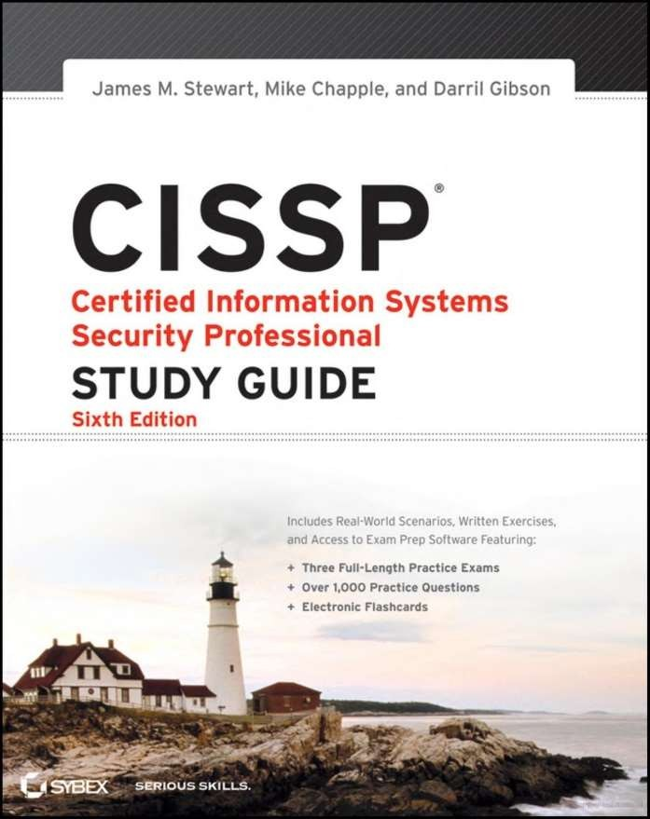

Slide 73
Class Activities
Task-1: Identifying the Multidisciplinary Approach Based on what you have learned so far about information security, what do you think is meant by “information security in a business context”? Think about other seemingly unrelated coursework you are taking and examine ways in which it can help build a foundation for a background in information security. CHAPTER 1 Why Study Information Security?
Task-2: Getting Some Practical Advice Select a local business or organization with a sizeable IT department (more than 100 IT employees), and identify the person in charge of information security. Interview the individual and ask for practical advice about the kind of training and experience the IT security manager is looking for in candidates.

Slide 74
Class Activity
EXERCISE: Evaluating Real-World Defense in Depth Find some analogies to the principle of defense in depth in the physical world, and make some diagrams of the mechanism you locate. Consider how a bank implements defense in depth and how corporations protect themselves from intruders entering their buildings.
EXERCISE-2: Identifying a Phishing Scam Go to www.opendns.com/phishing-quiz/ and take the “Think You Can Outsmart Internet Scam mers?” quiz. How well did you perform at identifying phishing scams?

Slide 75
Case Exercises
The next day at SLS (Secure Login System) found everyone in technical support busy restoring computer systems to their former state and installing new virus and worm control software. Amy found herself learning how to re-install desktop computer operating systems and applications as SLS made a heroic effort to recover from the attack of the previous day.
Discussion Questions
Do you think this event was caused by an insider or outsider?
Other than installing virus and worm control software, what can SLS do to prepare for the next incident?
Do you think this attack was the result of a virus or a worm?

Slide 76
CASE Exercise
Ethical Decision Making Often an attacker crafts e-mail attacks containing malware designed to take advantage of the curiosity or even greed of the recipients. Imagine that the message body Amy saw on the e mail from Davey had been “See our managers’ salaries and SSNs (Social Security Number)” instead of “Funniest joke you’ll see today.”
Would it be ethical for Amy to open such a file?
If such an e-mail came in, what would be the best action to take

